Slide 1
Fundament of IT
Old Question Solution: 2016 Fall

Slide 2
1.a. “ Information Technology is vital for modern business to make money”
Information system is such where data are collected, classified and put into process interpreting the result thereon in order to provide an integrated series of information for further communicating and analyzing.
An Information System is a particular type of work system that uses information technology to detain, put on the air, store, retrieve, manipulate or display information, thereby partisan one or more other work structure’.
Information System plays the role as ‘enabler and facilitator’

Slide 3
How IT helps business ?
Integration: The data and business processes of consulting organizations cross all phases of the engagement lifecycle: selling, planning, delivering, collecting and support
Reliability, Stability, and Security : Secure business computing is critical, and not only for the obvious reasons. When the clients know their data is in safe hands, it can be a competitive advantage for the company.
Global Capability: Capabilities such as multiple currency, multiple language, localization, and global customer support are critical for companies that cross, or want to be prepared to cross geographic, cultural, and business borders.

Slide 4
How IT helps business
Simplicity and Ease of Use: A system with a single source for data entry, an intuitive user interface, and minimal IT overhead will shorten learning curves, create higher morale among your team, and allow to do more with less.
Project Planning and Scheduling
Risk Management
HR Mangement
Historical Information (for Profitable and Competitive Bids)
Shared Documents and Collaboration

Slide 5
1.b. What are the component of IT
HARDWARE
SOFTWARE
DATABASE
NETWORK
PEOPLE
PROCEDURE

Slide 6
2.b. Computer Hardware
Personal Productivity | Organizational Productivity
Word processors | Networking capability
Email | Design aiding tools eg. CAD
Powerpoint presentation | Manufacturing aiding tools
Hardware for visual understanding/ Graphics | Desktop publication

Slide 7
1.c. Define Global Competition
Global competition is the services or products provided by competing companies that serve international customers.
Global competition has allowed companies to buy and sell their services internationally, which opens the door to increased profits and flattens the playing field in business.
With increased competition, new ways to differentiate their products and services need to be developed.
Need to acquire knowledge of other key competitors in the global marketplace

Slide 8
Define Changing Workforce
Advent of new technologies have changed the structure and working model of company.
Change in demography, working culture, expectations in employee

Slide 9
2.a. Data and Information
 | Data | Information
Meaning | Data is raw, unorganized facts that need to be processed. Data can be something simple and seemingly random and useless until it is organized. | When data is processed, organized, structured or presented in a given context so as to make it useful, it is called information.
Example | Each student's test score is one piece of data. | The average score of a class or of the entire school is information that can be derived from the given data.

Slide 10
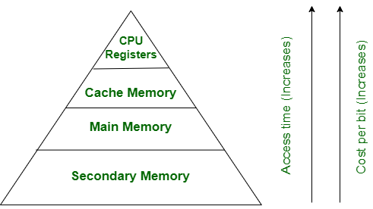
Primary and Secondary Memory

Slide 11
Memory
Primary Storage | Secondary Storage
Primary memory is temporary. | Secondary Storage is permanent
Primary memory is directly accessible by Processor/CPU. | Secondary memory is not directly accessible by Processor/CPU.
Nature of Parts of Primary memory varies, RAM- volatile in nature. ROM- Non-volatile. | It’s always Non-volatile in nature.
Primary memory devices are more expensive than secondary storage devices. | Secondary memory devices are less expensive when compared to primary memory devices.
The memory devices used for primary memory are semiconductor memories. | The secondary memory devices are magnetic and optical memories.
Primary memory is also known as Main memory or Internal memory. | Secondary memory is also known as External memory or Auxiliary memory.
Examples: RAM, ROM, Cache memory, PROM, EPROM, Registers, etc. | Examples: Hard Disk, Floppy Disk, Magnetic Tapes, etc

Slide 12
Artificial Intelligence vs Natural Intelligence
Artificial Intelligence (AI) is the designing of Intelligent or smart system which has the ability to perform accurate learning, reasoning and perception of the surrounding actions to produce maximum success whereas
Natural Intelligence or we can say Human Intelligence is the quality of the mind which has the ability to learn from past experience or situations we are currently facing to provide several kinds of information through that gained knowledge.

Slide 13
AI VS Natural Intelligence
 | Artificial Intelligence | Natural Intelligence
Energy Efficiency | 2 watts for modern machine learning machine | 25 watts human brain
Universal | While consuming kilowatts of energy, this machine is usually designed for a few tasks. | Humans usually learn how to manage hundreds of different skills during life.
Multitasking | Human worker work on multiple responsibilities | The time needed to teach system on each and every response is considerably high
Decision Making | Even the most advanced robots can hardly compete in mobility with 6 years old child. And this results we have after 60 years of research and development. | Humans have the ability to learn decision making from experienced scenarios.
State | Digital State | Brains are Analogue

Slide 14
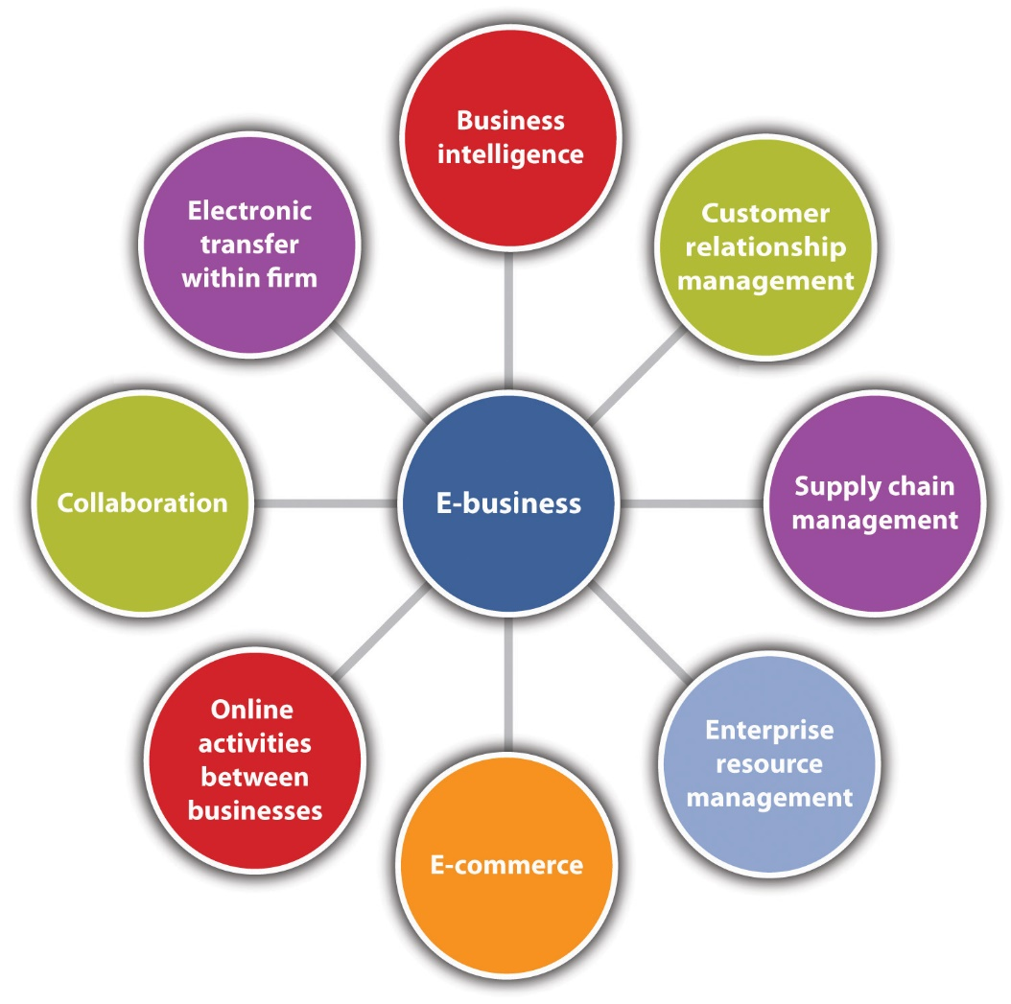
E-Business

Slide 15
E-Business vs E-Commerce
Basis of Comparison | E-Commerce | E-Business
Definition | Trading of merchandise, over the internet | Running business using Internet
What is it? | Subset | Superset
Limited to monetary transaction? | Yes | No
What they carry out? | Commercial Transaction | Business Transaction
Approach | Extroverted | Ambiverted
Requires | Website | Website, CRM, ERP
Network | Internet | Internet, Extranet,Intranet

Slide 16
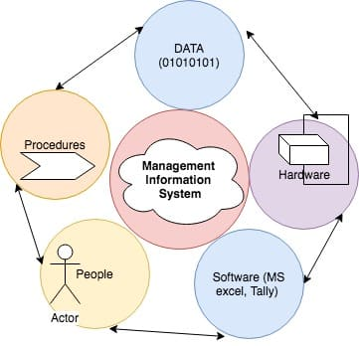
MIS: Management Information System

Slide 17
MIS
MIS is an organizational method of providing past, present and projected information related to internal operations and external intelligence.
The MIS satisfies the diverse needs through variety of systems such as query system, analysis system, modeling system and decision support system.
The MIS helps in strategic planning, management control, operational control and transaction processing. The MIS helps in the clerical personal in the transaction processing and answers the queries on the data pertaining to the transaction, the status of a particular record and reference on a variety of documents.

Slide 18
MIS
The MIS helps the junior management personnel by providing the operational data for planning, scheduling and control , and helps them further in decision-making at the operation level to correct an out of control situation.
The MIS helps the middle management in short term planning, target setting and controlling the business functions. It is supported by the use of the management tools of planning and control.
The MIS helps the top level management in goal setting, strategic planning and evolving the business plans and their implementation.
The MIS plays the role of information generation, communication, problem identification and helps in the process of decision-making. The MIS, therefore, plays a vital role in the management, administration and operation of an organization.

Slide 19
EFT VS EDI
Electronic data interchange (EDI), or electronic data processing, is the electronic transmission of data between computers in a standard, structured format.
Electronic funds transfer (EFT) is the term used for electronic data interchanges that involve the transfer of funds between financial institutions.

Slide 20
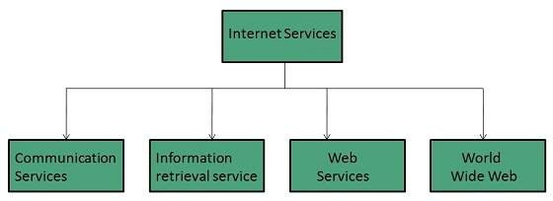
Services Provided by Internet

Slide 21
Communication Services
Email: send electronic mail
Telnet: Log unto remote coputer
Newsgroup:Offers a forum for people to discuss topics of common interests.
Internet Relay Chat (IRC):Allows the people from all over the world to communicate in real time.
Mailing Lists:Used to organize group of internet users to share common information through e-mail
Internet Telephony (VoIP):Allows the internet users to talk across internet to any PC equipped to receive the call
Instant Messaging:Offers real time chat between individuals and group of people. Eg. Yahoo messenger, MSN messenger.

Slide 22
Information Retrieval Services
File Transfer Protocol (FTP) Enable the users to transfer files.
Archie It’s updated database of public FTP sites and their content. It helps to search a file by its name.
Gopher Used to search, retrieve, and display documents on remote sites.
Very Easy Rodent Oriented Netwide Index to Computer Achieved (VERONICA) VERONICA is gopher based resource. It allows access to the information resource stored on gopher’s servers.

Slide 23
Factors Affecting Microprocessors
Frequency of clock: Higher the frequency, smaller the time period , leading to faster execution of instructions
Word length: Bigger word length implies manipulating more number of bits at one go, resulting in higher speed
Width of the bus: Width of the bus lower than the word length would imply that a multi- byte word has to be transferred in instalments , thereby slowing down the processor.
Architecture of the bus: A multi- bus structure scores over a single bus structure by providing additional paths for parallel transfers, thereby increasing overall speed.
RISC: Reduced Instruction Set Architecture results in higher speed

Slide 24
Groupware Advantages
Definition: Collaborative software or groupware is application software designed to help people working on a common task to attain their goals
Allows for communication and collaboration among group members
You can keep track of the changes, who made them, and how they affect the project
Group members can telecommute, which means the group members don't have to be present
No Travel costs involved with Groupware since people don't actually have to meet up
Allows for problem solving as a group
Allows for workers in the business world to keep in touch when they are not in the office

Slide 25
Issues Faced by E-Tailers
E-Tailer: a retailer selling goods via electronic transactions on the Internet
Global and Legal Issue
Ease of Access
Design Issues
Privacy vs. Personalization Issue

Slide 26
Issues for E-Tailer
Not all customers have access to the web, as they do to the postal system. This is a temporary issue as the evolution of the web continues.
Ease of use is a problem, as the web design is still complex, or at least somewhat chaotic. E-tail stores are not standardized in design in the way catalogs and retail stores have become. Therefore different user bahaviors (navigation schemes) need to be learned for each e-tail store. This is a temporary issue as the evolution of the web continues.
Trust, security and privacy concerns prevail. Consumers are concerned with the use of the data they provide during transactions.
Graphic presentation is not as compelling for the web as it can be for catalogs. This is a temporary issue as the evolution of the web continues.

Slide 27
Decision support systems
Decision support systems (DSS) are interactive software-based systems intended to help managers in decision-making by accessing large volumes of information generated from various related information systems involved in organizational business processes, such as office automation system, transaction processing system, etc.
DSS uses the summary information, exceptions, patterns, and trends using the analytical models.
A decision support system helps in decision-making but does not necessarily give a decision itself. The decision makers compile useful information from raw data, documents, personal knowledge, and/or business models to identify and solve problems and make decisions.

Slide 28
Attributes of DSS
Adaptability and flexibility
High level of Interactivity
Ease of use
Efficiency and effectiveness
Complete control by decision-makers
Ease of development
Extendibility
Support for modeling and analysis
Support for data access
Standalone, integrated, and Web-based

Slide 29
Benefits of DSS
Improves efficiency and speed of decision-making activities.
Increases the control, competitiveness and capability of futuristic decision-making of the organization.
Facilitates interpersonal communication.
Encourages learning or training.
Since it is mostly used in non-programmed decisions, it reveals new approaches and sets up new evidences for an unusual decision.
Helps automate managerial processes.

